Slide 1
Notes: 1. Correct fonts won’t load until you open this in PowerPoint (e.g., if you’re previewing this in your browser it’ll look not quite right). 2. Generate QR codes here: https://www.qrcode-monkey.com/

Slide 2
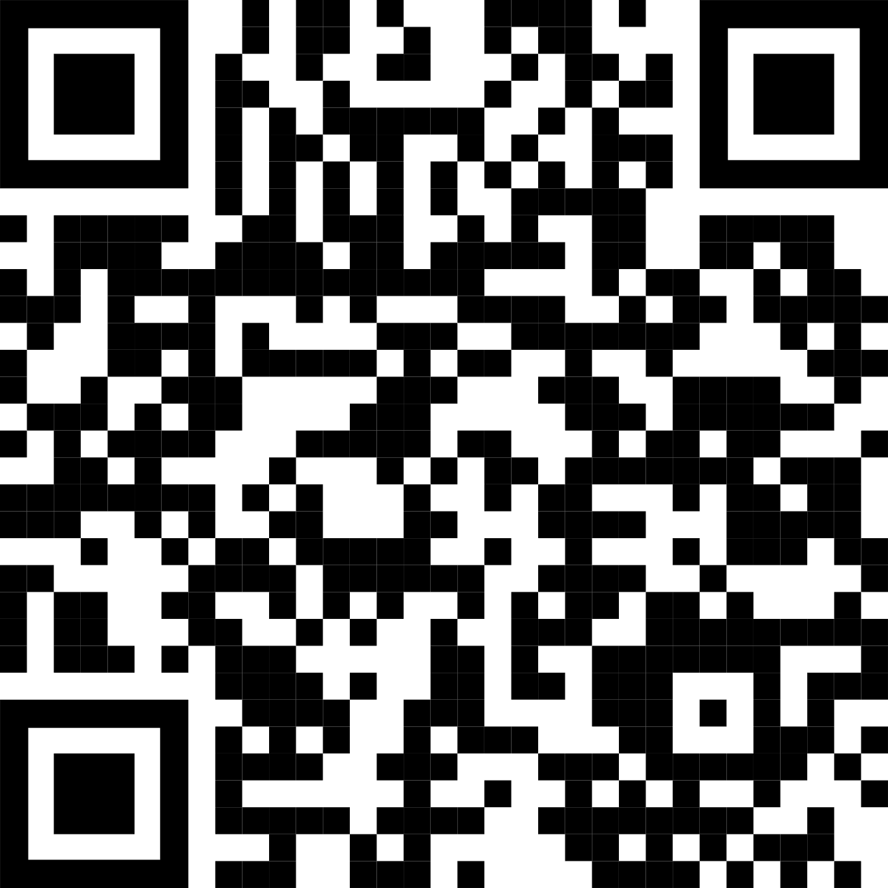
Main finding goes here, translated into plain English. Emphasize the important words.
Non-Cognitive Predictors of Student Success: A Predictive Validity Comparison Between Domestic and International Students
Non-Cognitive Predictors of Student Success: A Predictive Validity Comparison Between Domestic and International Students
Title: Subtitle
AMMO BAR
Delete this and replace it with your…
Extra Graphs
Extra Correlation tables
Extra Figures
Extra nuance that you’re worried about leaving out.
Keep it messy! This section is just for you.
PRESENTER: John Doe
INTRO:
Who cares? Explain why your study matters in the fastest, most brutal way possible (feel free to add graphics!).
METHODS
How did you find this?
Collected [what] from [population]
How you tested it.
Illustrate your methods, if you can!
RESULTS
Graph/table with essential results only.
All the other correlations in the ammo bar.
Leeroy Jenkins, author2, author3, author4, author5, author6, author7, author42
Take a picture to download the full paper

Slide 3
Main finding goes here, translated into plain English. Emphasize the important words.
Non-Cognitive Predictors of Student Success: A Predictive Validity Comparison Between Domestic and International Students
Non-Cognitive Predictors of Student Success: A Predictive Validity Comparison Between Domestic and International Students
Title: Subtitle
AMMO BAR
Delete this and replace it with your…
Extra Graphs
Extra Correlation tables
Extra Figures
Extra nuance that you’re worried about leaving out.
Keep it messy! This section is just for you.
PRESENTER: John Doe
INTRO:
Who cares? Explain why your study matters in the fastest, most brutal way possible (feel free to add graphics!).
METHODS
How did you find this?
Collected [what] from [population]
How you tested it.
Illustrate your methods if you can!
RESULTS
Graph/table with essential results only.
All the other correlations in the ammo bar.
Leeroy Jenkins, author2, author3, author4, author5, author6, author7, author42
Take a picture to download the full paper

Slide 4
F.A.Q.
Frequently Asked Questions

Slide 5
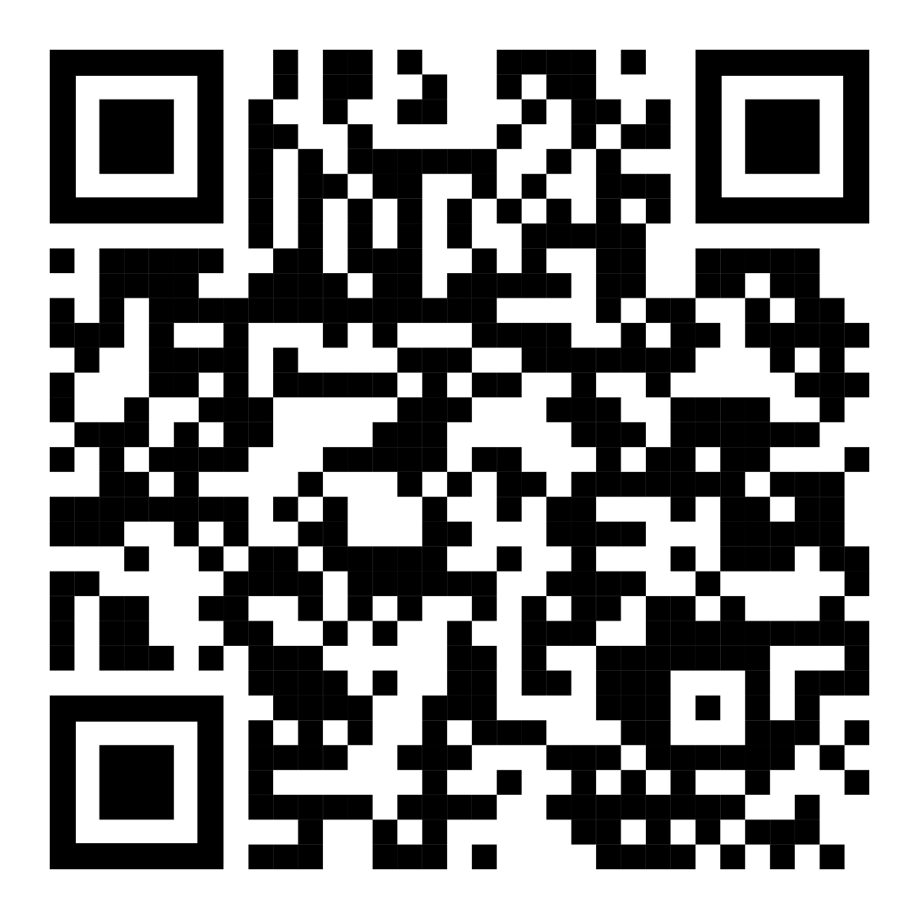
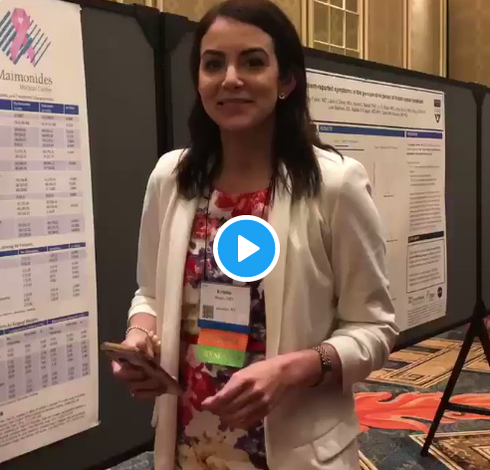
How to QR Code
How do I create a QR code?
https://www.qrcode-monkey.com/ is free, URLs don’t expire, and you can add cool features like images.
How do I scan a QR code?
Just pull out your phone and take a picture! All modern iPhones and most Android phones have built-in QR detection in their cameras. Some Android phones may need an app.
How can I link the QR to my paper and a copy of my poster and my contact details.
Try creating a multi-page link for free via https://linktr.ee/. (Still trying to figure out the best answer to this though.
Ctrl-click this thumbnail to watch a video on scanning #betterposter QR codes.
Donated by @kristinrojasmd
https://twitter.com/kristinrojasmd/status/1124418213050298368

Slide 6
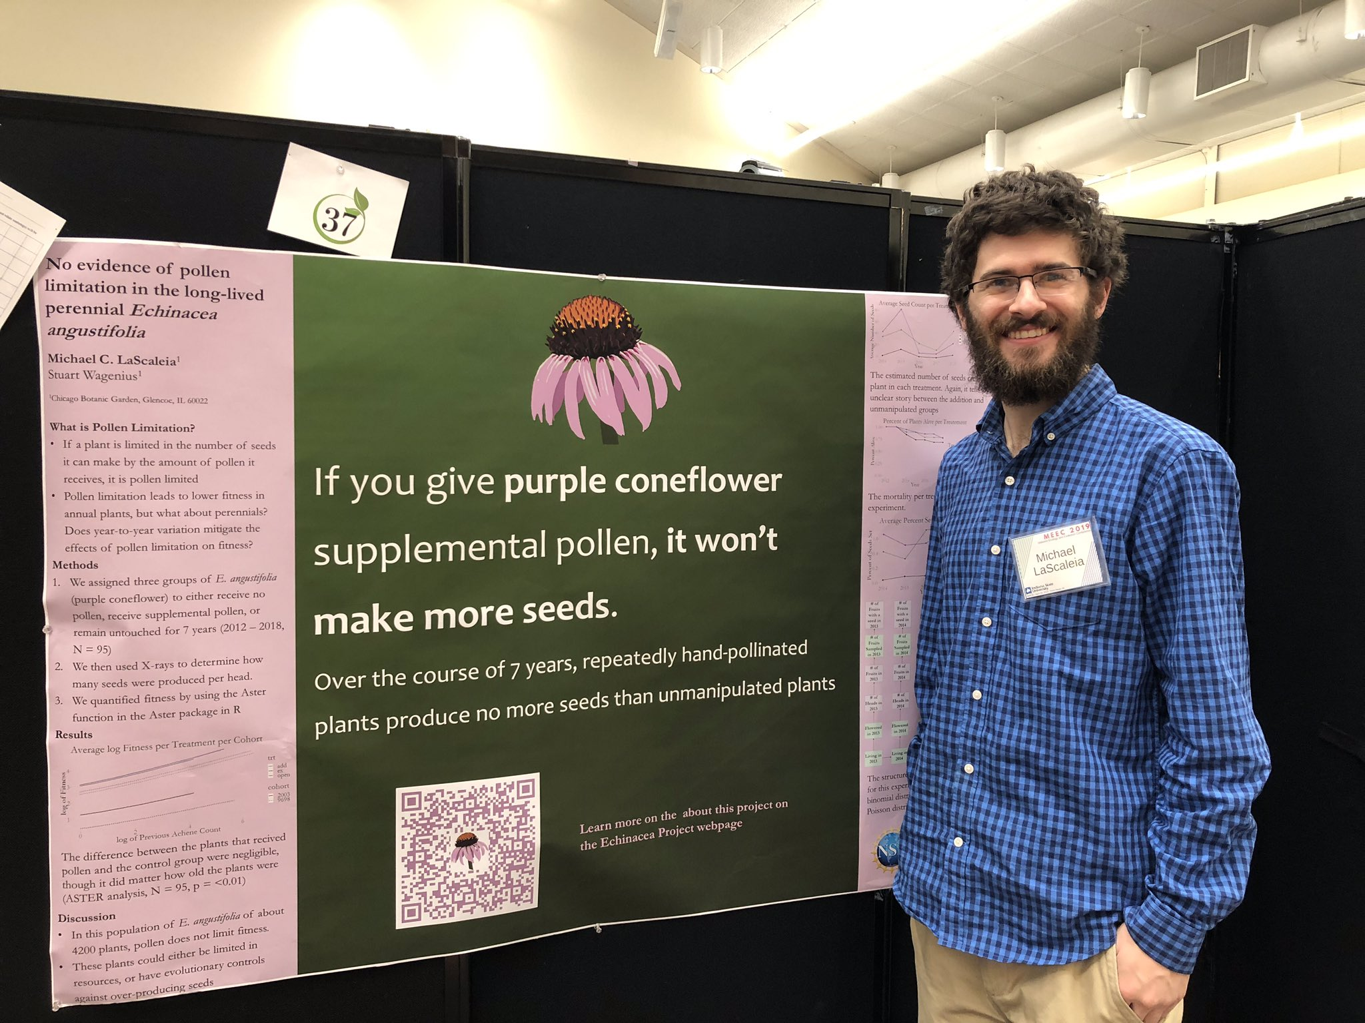
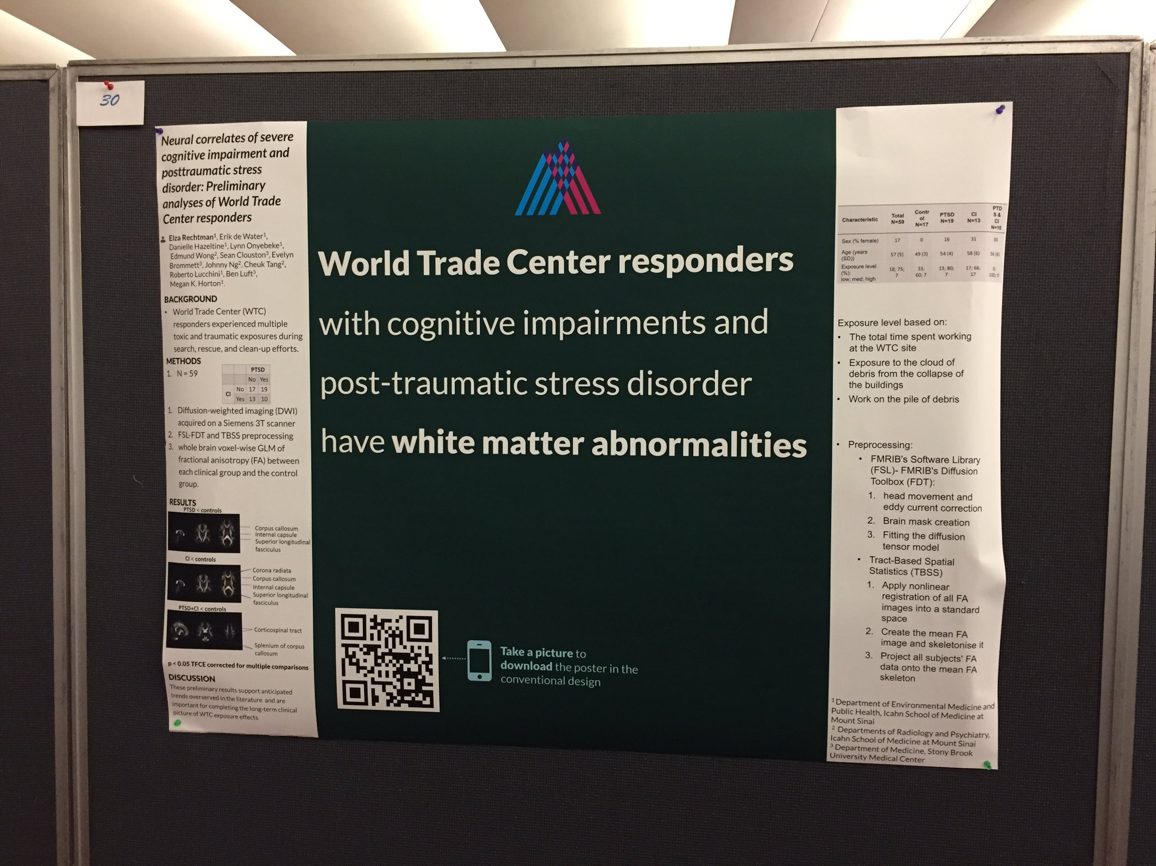
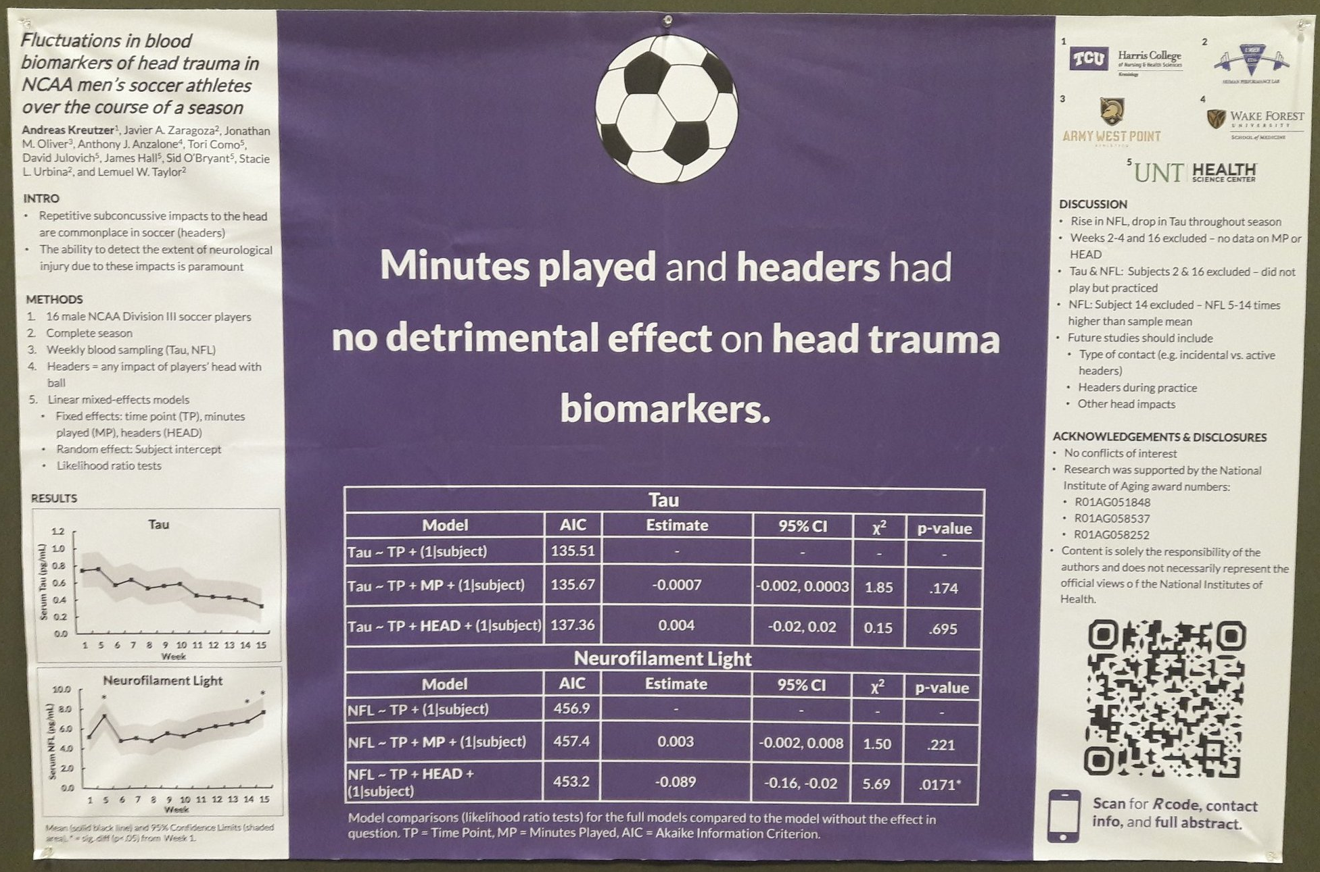
Add a ‘hat’ icon Fun, reinforces your finding, makes your poster memorable — and can be interpreted at a glance.
Example donated by @MCLaScience
Example donated by @DStroumsa
Example donated by @ElzaRechtman
Example donated by @mikemorrison
Example donated by @akreutzer82

Slide 7
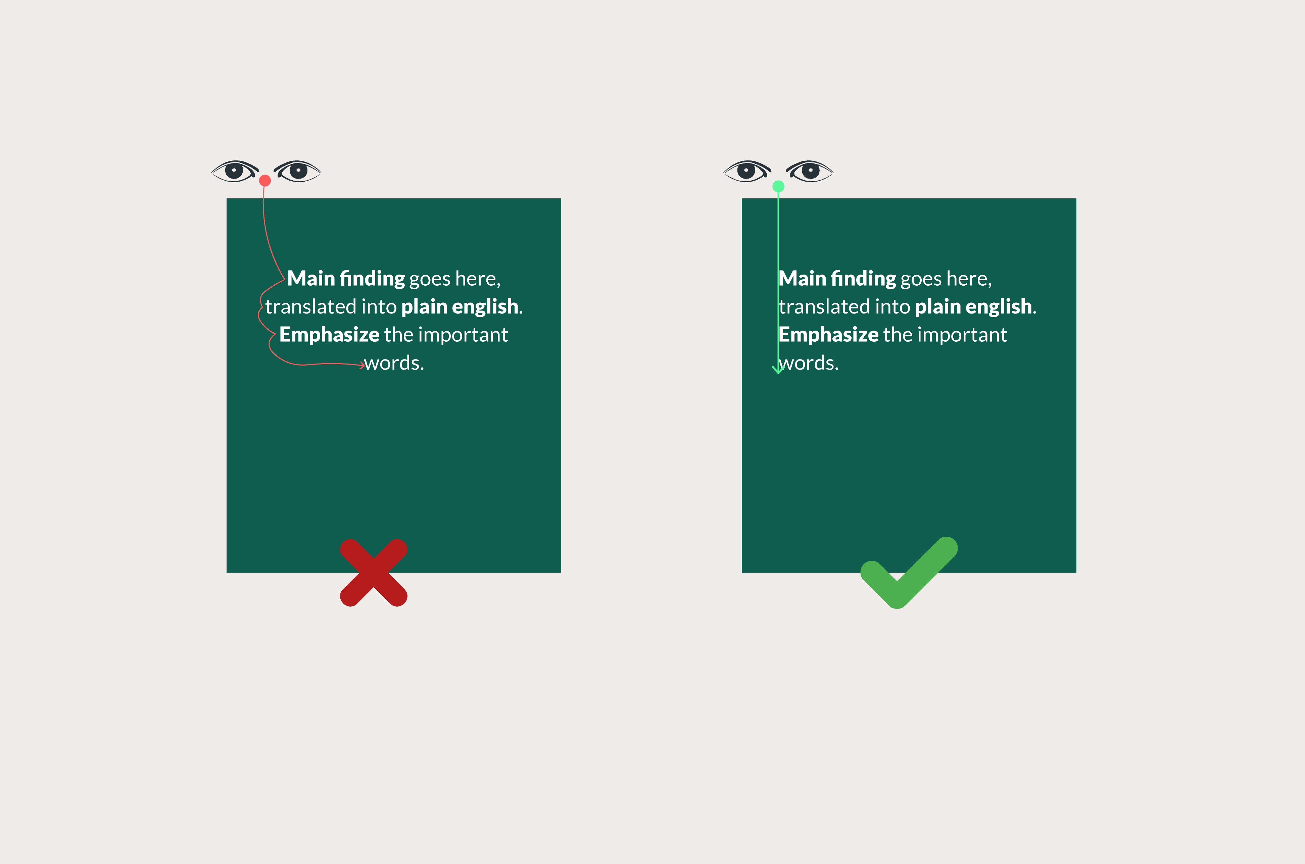
If your punchline is more than 2 lines, don’t center it. Centering makes your eyes do more work.

Slide 8
Layout F.A.Q.
What if my intro/methods/results doesn’t fit in the silent bar?
If you’re trying to put so much into that bar that it doesn’t fit, they won’t have time to read it anyway. First try moving stuff to the ammo bar. Next, edit.
Instead of trying to fill space, you’re trying to conserve space.
What if I have a really important graph or picture?
Move the QR Code to the Silent Presenter, then put your graph/image in the middle.

